Slide 1

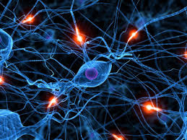
NEURAL NETWORKS
Representation – Problems – Perceptrons

Slide 2
Table of contents :
1. Foundations of Neural Networks
4. Perceptrons: The Fundamental Unit
Introduction:
How It Works (Step-by-step):
Perceptrons - Linear Separability
Overview of Neural Networks
Core Components
2. Neural Network Architecture
Interconnection
5. Challenges and Problems in Neural Networks
Overfitting, Underfitting , causes.
Gradient problems.
Limitations.
3. Mathematical Representation
Of Neural Networks

Slide 3
1
Overview of neural networks :
Origins :
Early Theories: Neural networks trace their roots to the 1940s with the McCulloch-Pitts model, the first mathematical representation of a neuron.
Originally used to model biological neural networks,
The human brain inspires neural networks.
Designed to mimic the brain's ability to recognize patterns and make decisions.
Key Biological Inspiration :
Structure and Function: Replicate the structure and function of biological neurons in the human brain.

Slide 4
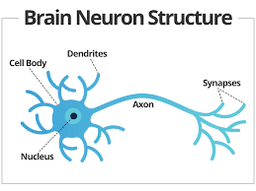
2
Core Components :
Neurons :
Function: Act as processing units in the network.
Role: Receive input, apply a mathematical function, and produce an output.
Synapses/Weights :
Function: Represent the strength of connections between neurons.
Role: Determine the influence of one neuron's output on another.
Connections :
Enable the transmission of data through layers, facilitating complex processing.
BRAIN NEURON STRUCTURE -->

Slide 5
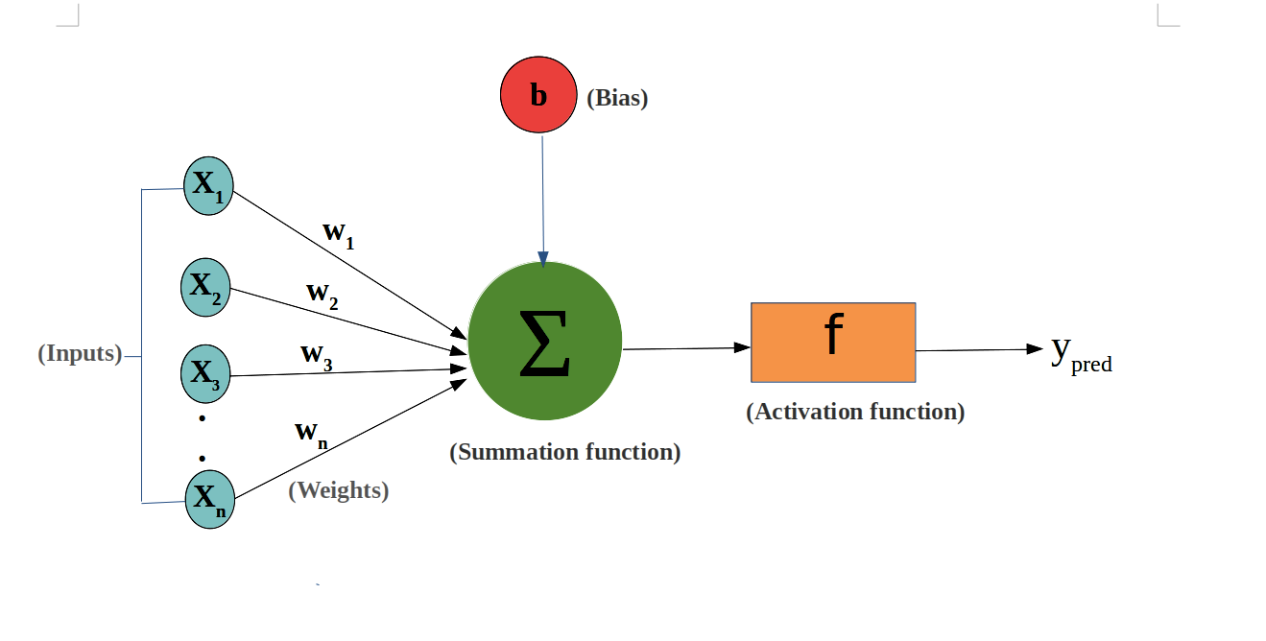
3
Neural Network Architecture
Input, Hidden, and Output Layers,
Understanding the Role of Weights and Biases
Activation Function

Slide 6

4
Interconnections:
Single-layer feed-forward network
Multilayer feed-forward network
Single node with its own feedback
Single-layer recurrent network
Multilayer recurrent network

Slide 7
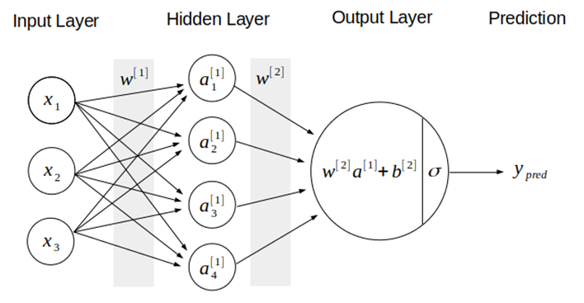
Mathematical Representation of Neural Networks
5
•The general idea of a Neural Network is to a model that, based on a set of N samples of dataset D,
D= [x_1… x_n] [ Y_1…Y_n]
•Input as a Vector: The input to a neural network is often represented as a vector x_i∈R_n, where each element of the vector corresponds to a feature of the input data.
Y=W.X+b
•Linear Transformation: Each neuron performs a linear transformation of the input:
Y=W^T . X+b
X={x1,x2...xn}
W={w11,w12....w1i:wn1,wn2....wni}
b={b1,b2,....bn}

Slide 8
6
Activation Function: The neuron applies an activation function a=f(z) to introduce non-linearity:
Ramp Function:
f(z)=max(0,Z)
Sigmoid Function:
f(z)=1/1+e^-z
Loss Function:The loss function measures the difference between the predicted output y^​ and the actual target y.
Mean Squared Error (MSE) for regression:
L(y,y^)=1/n sum(y^ -yi)
Cross Entropy for Classification:
L(y,y^)=1/n sum(yi)log(y^i)

Slide 9

Perceptrons: The Fundamental Unit
7
Introduction:
Perceptrons are the simplest form of a neural network.
They are primarily used for binary classification (e.g., yes/no, true/false).
How It Works (Step-by-step):
Inputs: Each input (e.g., features from the data) is assigned a weight.
Weighted Sum: The inputs are multiplied by their respective weights and added together.
Bias: A bias is added to shift the output if necessary.
Activation Function: The result is passed through an activation function (e.g., step function or sigmoid).
Output: The perceptron generates an output, typically a 0 or 1 (binary classification).

Slide 10
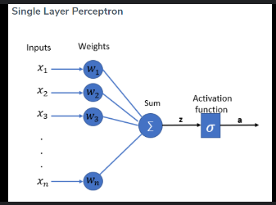
8
Perceptrons - Linear Separability
Linear Separability:
Linear separability means that the data can be divided into two classes by a straight line (or hyperplane in higher dimensions).
Single-layer perceptrons can only handle problems that are linearly separable (e.g., separating red and blue dots with a straight line).

Slide 11

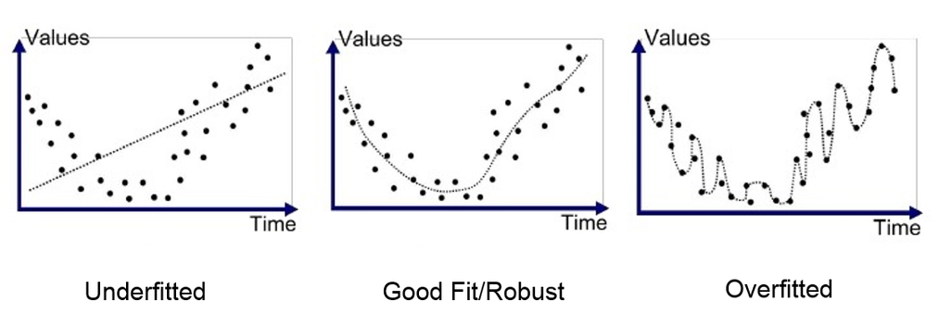
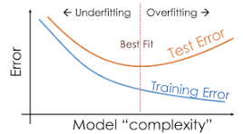
Challenges in neural networks:
9
Overfitting & Underfitting:
1) What? 2) When? 3) Tackling?
Vanishing & Exploding gradient problems:

Slide 12
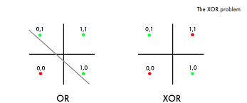
10
Limitations of perceptrons:
Linear separability
(AND or OR operations):
XOR problem:
Evolution to MLPs

Slide 13

11
What we have learnt?
Questions Time

Slide 14
THANK YOU

